Slide 1
Vogel’s Algorithm
Vlad Akavets

Slide 2
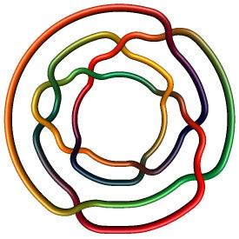
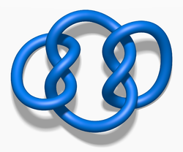
Links vs Closed Braids

Slide 3
Links vs Closed Braids
Link is any locally flat (“nice”) 1 dim closed submanifold
Braid imposes additional conditions. Briefly: we pick some coordinate axis, moving along a closed braid would define a consistent rotation around that axis (vector from origin to point on a braid will be rotating consistently). Kind of like we wrap it around a cylinder (or cone).

Slide 4
Proof Outline
Introduce definitions that we will need

Slide 5
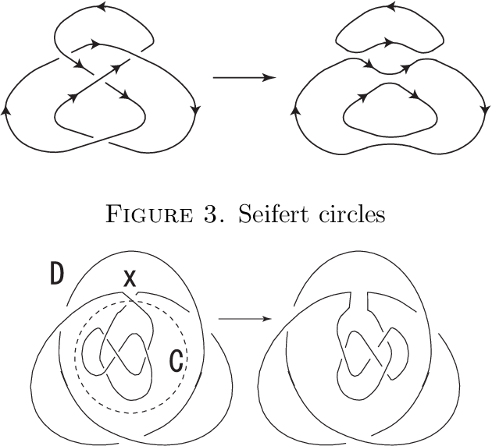
Smoothing and Serfeit Circles
Smoothing - take a crossing and “uncross” it (remember A and B moves?), but here, because of the orientation we have deterministic way to do it.
We end up with disjoint circles which are called Serfeit.

Slide 6
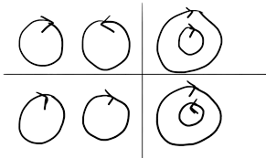
Compatibility

Slide 7
Multiple Definitions
Height of a diagram - number of incompatible pairs.
Face of a link - connected component of its complement
Face adjacent to circle - segment of a knot which then becomes part of that circle is in the closure of the face
Defect face - face adjacent to incompatible circles
Reduction arc - arc lying in defect face connecting two segments of the circles which make it defect

Slide 8
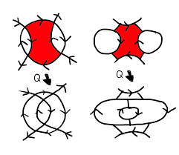
Bending
Push a segment along reduction arc and the slide it over another segment.
Bending is R2 move, so we keep link isotopic to the original one

Slide 9
Proof Outline
Introduce definitions that we will require
Show that bending decreases height of a diagram by 1

Slide 10
Case 1: not concetric, oriented same circles
height before = h + d1 + d2 + 2d + 1
h - incompatible pairs independent of S1 and S2
d1 - circles inside S1, d2 - circles inside S2
d - circles outside (S1US2) and incompatible with S1
height after = h + d1 + d2 + 2d
d1, d2 now in S3, but out S0
d - same as before

Slide 11
Case 1: concetric, oriented differently circles
height before = h + d1 + d + 2d2 + 1
d1 - within S0 (and therefore S3)
d2 - within S3 but not S0, incompatible with S0
d - outside S3
height after = h + d1 + d + 2d2
d1 now outside both S1 and S2
d2 inside S1, incompatible with both
d - outside union(S1, S2)

Slide 12
Proof Outline
Introduce definitions that we will require
Show that bending decreases height of a diagram by 1
Show that height > 0 -> there is a defect face

Slide 13
Defect Face: Find Component on Serfeit Diagram
Pick two incompatible circles S1, S2. Draw an arc C between them, such that it crosses each circle in at most 1 point (that is when we try to get from outside of some cicle to inside and vice versa). Incompatible = one circle crosses C from left to right, other from right to left (pick an orientation on C). Because endpoints (S1 and S2) are, there must be two consecutive crossings with incompatible circles. Thus we have found component needed, but it is not necessary a face yet.

Slide 14
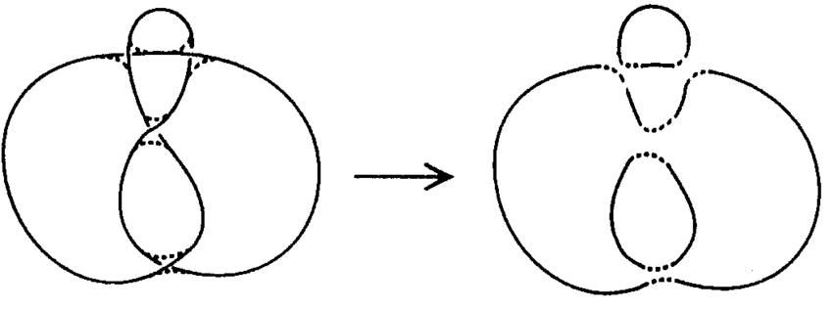
Why not a Face?

Slide 15
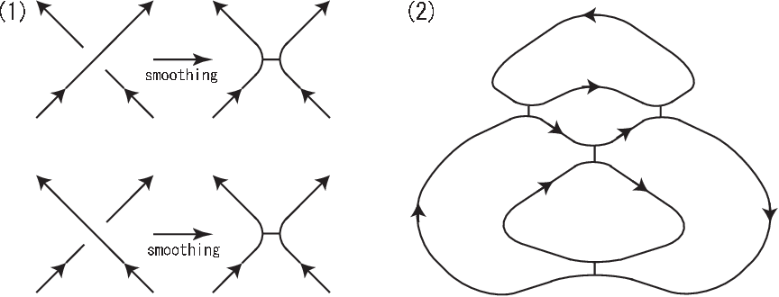
Defect Face: Find One in the Component
If our component is a face we are done. Otherwise it is split by segments connecting smoothed crossings. Any face is adjacent to at least 2 circles. Adjacency to 3 will always give incompatibility, so say it is only 2. When we cross to the neighboring face over connecting segment, we meet same circles. All faces of the component are connected this way, so these must be the only circles in the component. But then they are incompatible by our assumption.

Slide 16
Proof Outline
Introduce definitions that we will require
Show that bending decreases height of a diagram by 1
Show that height > 0 -> there is a defect face
Show that we can reduce the link to have compatible concentric circles as Serfeit diagram

Slide 17
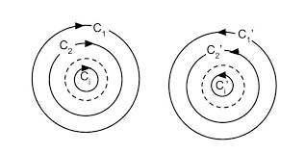
Almost There
Steps 2 and 3 imply that we can obtain a link with height 0 from any given one. What is a general form of a diagram with height 0?

Slide 18
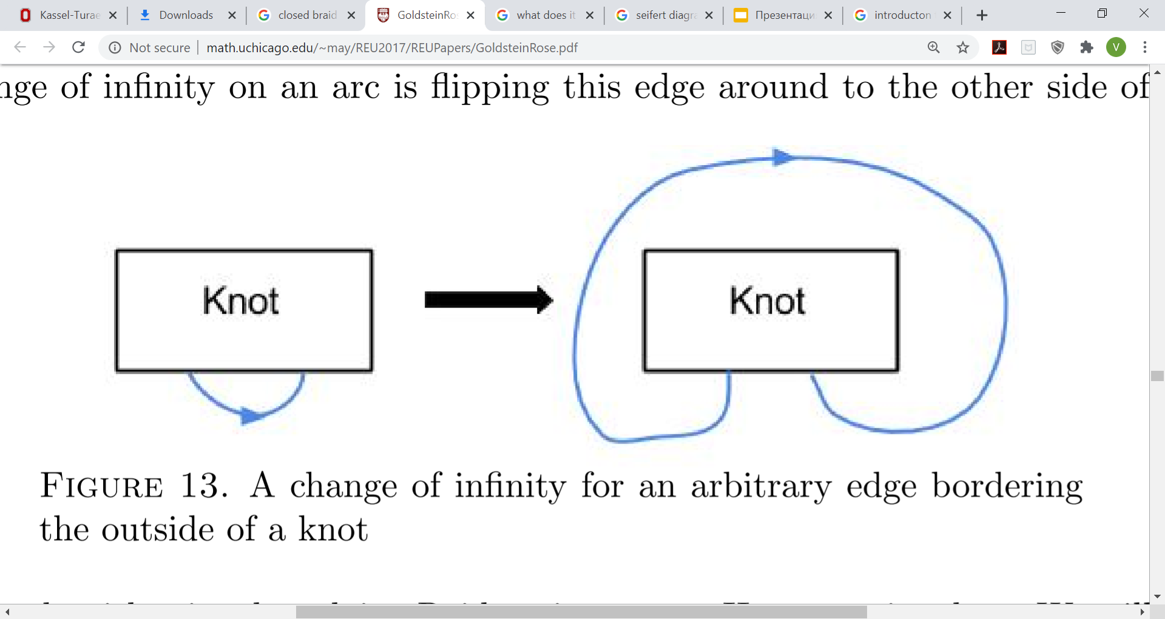
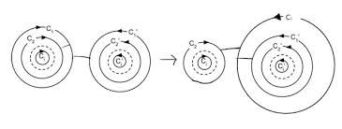
Change of Infinity

Slide 19
Proof Outline
Introduce definitions that we will require
Show that bending decreases height of a diagram by 1
Show that height > 0 -> there is a defect face
Show that we can reduce the link to have compatible concentric circles as Serfeit diagram
Explain why step 4 implies it is a closed braid

Slide 20
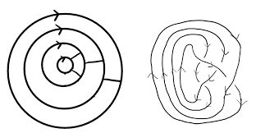
Braids and Serfeit Diagrams
Intuition: being a braid is about consistent orientation and ‘cylindrical’ shape. Such a diagram ensures both.

Slide 21
Being a Braid...

Slide 22
References
Kassel-Turaev Braid Groups
https://link.springer.com/book/10.1007/978-0-387-68548-9
INTRODUCTION TO KNOTS AND BRAIDS USING SEIFERT CIRCLES
http://math.uchicago.edu/~may/REU2017/REUPapers/GoldsteinRose.pdf

